Slide 1


TOP 5 CATEGORIES

Slide 2


Today's agenda
Project recap
Problem
The Analytics team
Process
Insights
Summary

Slide 3

Social Buzz
Social Buzz needs to adopt measures to compete on a global scale, and has engaged Accenture to make sure of that. This includes the following tasks:
An Audit of Social Buzz’s big data practice
Recommendations for a successful IPO
Analysis to find the top 5 most popular categories of content
Project Recap

Slide 4

Problem
The problem here is how to make sense of so many posts and contents on a yearly basis. Hence the analysis to find out the most popular categories of content and focus on that.

Slide 5



Somebody Anyone
Project Manager
The Analytics team
Hey Stranger
Head of Operations
Yo Me
Data Analyst

Slide 6
Process
1
Understand the data
2
Clean the data
3
Model the data
4
Analyse the data
5
Make inference

Slide 7

Insights
16 UNIQUE CATEGORIES
ANIMALS CATEGORY WITH THE MOST REACTIONS
JANUARY MONTH WITH THE HIGHEST NUMBER OF POSTS

Slide 8
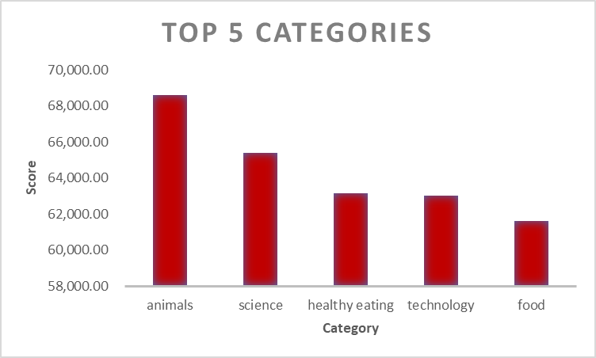

Slide 9
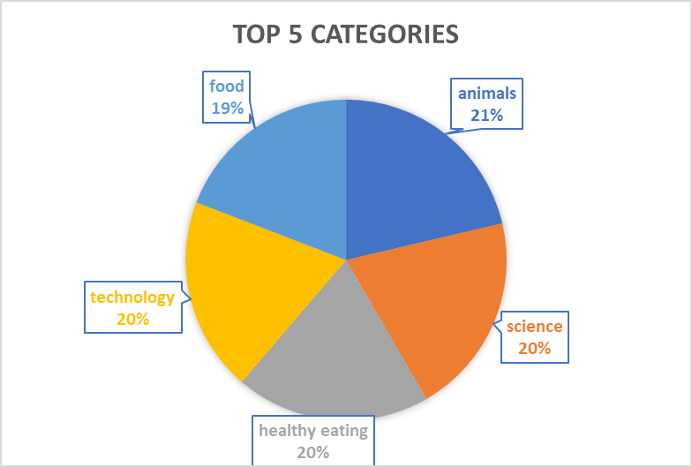

Slide 10

ANALYSIS
Animals and science are the two most popular categories. This means that people tend to engage more with real-world content.
INSIGHT
Four of the top 5 categories include science, technology, food, and healthy eating. Working with science and technology and food-related content can go a long way to boost user-engagement.
Summary

Slide 11
Thank you!
ANY QUESTIONS?

